Slide 1
[ III ] Grandchildren of Hans & Maria: Third Generation Norwegian-American
Back to
Procedure Page

Slide 2
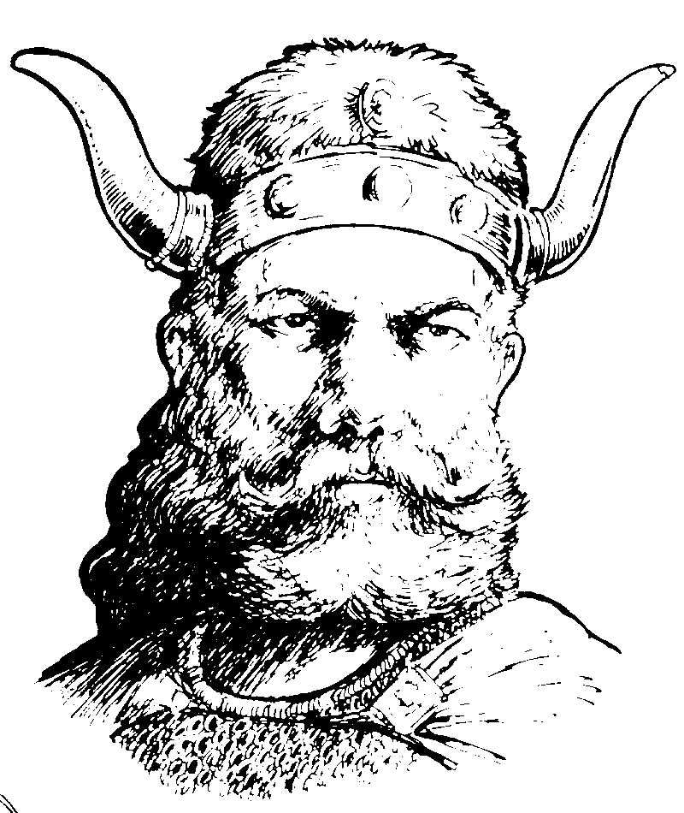
[ III ] : Family Tree Branches: Hubert Vennes Fortney
Third Generation Norwegian American
Son of Albert Christian Fortney [II]
Name: Alan Dale Fortney
B/Plc: 31 May 1946,
D/Plc:
Occupation:
S/C: Pamela [d 2006] ; 2 dau Kris & Kerry
Name: Hubert Vennes Fortney
Born: 26 April 1922, Wheeler WI
Deceased: 5 January 2005, Woodale IL
Occupation: Electicsal enginer
Married:
Place: Minneapolis, MN
Name: Evelyn Matilda Yaun Born: 23 December1920, Knap WI
Deceased:
Occupation: Worked for Sears (ret.)
Hubert & Evelyn Fortney
1 son,
2 grand daughters
4 great granddaughters

Slide 3
[ III] : Family Tree Branches: Virgil Fortney
Third Generation Norwegian American
Son of Albert Christian Fortney [II]
Name: Phillip
B/Plc: 16 August 1948
D/Plc:
Occupation: Guidance Conselor [ret.]
S/C: Ngoc Kim Duan [Saigon, Vietnam 18 Aug 1966]; 0
Name: Virgil A. Fortney
Born: 12 September 1925
Deceased: 1 January 1982
Occupation: Sales
Name: Robert
B/Plc: 23 November 1953
D/Plc:
Occupation: Director – Ortho & Neurological ICU
at Northwestern Hospital in Chicago
Partner: Mark Schmantz [Tenor, Chicago Opera]
Married: 15 June 1946 [Dv. 1962]
Place: Seminole, Oklahoma
Name: Betty Baker
Born: 18 December 1927
Deceased:
Occupation: wife, mom, sales, hairdresser
Name: Marcia Attmore
B/Plc: 8 February 1951
Occupation: executive recruiter
S: Dick Weber; 1973.
S/C: Wynn Blair; 1985. 1 dau., Leslie Blair [8 April 1986; Oakfield Conn.]
S/C: George Attmore,Computer consultant, 1999; 0
Married [6 June 1964]: Al Vriesakker
Born: 10 June 1917
Deceased: 19 April 2006
Occupation: unk
Virgil and Betty Fortney had
2 sons; 1 dau
1 grand daughter

Slide 4
[ III ] Family Tree Branches: Adrian Hilman Dahl
Third Generation Norwegian American
Son of Tonetta Marthia [II] (“Nettie”) & Frederick Dahl
Name: David Adrian Dahl
B/Plc: 5 June 1944, Oak Ridge TN
D/Plc:
Occupation: Electrical engineer (ret.)
S/C: Elizabeth; 1 son, 3 adopted children
Name: Adrian Hillman Dahl
B/Plc: 6 December 1919
D/Plc: 2 December 2002; Loveland, CO
Occupation: Nuclear Physicist; professor
Married: February 1942
Place: Rochester NY
Name: Virginia Dahl [1st of 4 wives]
B/Plc: 28 January 1921, Robinson KS
D/Plc: 1983, Ft. Collins.
Occupation:
Name: Sonje Ann Dahl Jessen
B/Plc: 1 July 1946
D/Plc:
Occupation:
S/C:
Adrian & Virginia Ddahl
1 son; 1 daughter
3 grandsons,
+ 4 adopted grandchildren

Slide 5
[ III ] Family Tree Branches: Monrad Kenneth Dahl
Name: David Frederick Dahl
B/Plc: 24 October 1948, Glenwood City WI
Occupation: Minister, psychologist
S/C: Maritza Gerbrandy; 1 son; 2 dau.
Third Generation Norwegian American
Son of Tonetta Marthia [II] (“Nettie”) & Frederick Dahl
Name: Jon Arthur Dahl
B/Plc: 29 January 1950, Amery WI
Occupation: Scientist; ecologist
S/C: Kathleen Joan “Kate” Hiemenz; 1 son, 1 dau.
Name: Monrad Kenneth Dahl
B/Plc: 28 August 1921
D/Plc: 6 January 1993; St. Cloud, MN
Occupation: Teacher; Recreation Therapist
Name: Mark Thomas Dahl
B/Plc: 14 August 1951, Harmony, MN
Occupation: Orthopedic surgeon
S/C: Katherine Killeen; 3 dau. (Dana Marie, Lindsay, Jenny)
Married: June 1946 or 47
Place: UNK
Name: Deborah Susan Dahl
B/Plc: 30 March 1953, St. Paul, MN
Occupation: Occupational Therapist
S/C: Peter Van Wolvelaerd (Div.); 2 dau.(Megan, Arielle)
Name: Jeanette (Jan) Higgins
B/Plc: 7 January 1922,
D/Plc:
Occupation: teacher, musician, occupational therapist
Name: Daniel Stephen Dahl
B/Plc: 21 January 1957, St. Cloud, MN
Occupation: Computer Programmer
S/C: Joni Hall; 1 son (Andrew), 1 dau.(Sarah)
Monrad & Jeanette Dahl:
6 children,
14 grandchildren;
5 great grand children
Name: Peder Monrad Dahl
B/Plc: 30 April 1963; St. Cloud, MN
Occupation: Physical Therapist
S/C: Cristy Harris; 1 son (Alex), 1 dau. (Katerine)

Slide 6
[ III ] Family Tree Branches: Frederick Dahl
Third Generation Norwegian American
Son of Tonetta Marthia [II] (“Nettie”) & Frederick Dahl
Name: Tolana Marie
B/Plc: 28 January 1950
Occupation:
S/C: Charles Brown; 1 dau. (Deanna)
Name: Frederick Thomas
B/Plc: 25 May 1951
Occupation: military
D/Plc: when/where in service?
Name: Frederick
Born: 10 September 1923
Deceased:
Occupation:
Name: Edward Luke Dahl
B/Plc: 19 August 1951
D/Plc: 31 July 1969
Occupation: Tractor accident on a farm
S/C: none/none
Married:
Place:
Name: Rosemary
Born:
Deceased:
Occupation:
Name: Randi Elizabeth
B/Plc: 25 November 1953
Occupation:
S/C: unknown
Name: Steven Kendal
B/Plc: 25 March 1955
Occupation:
S/C: Sylvia; 1 son (Tommie)

Slide 7
[ III ] Family Tree Branches: Sylvia Dahl Kromroy Goll
Third Generation Norwegian American
Daughter of Tonetta Marthia [II] (“Nettie”) Fortney & Frederick Dahl
Name: Sylvia Dahl Kromroy Goll
B/Plc: 25 February 1926; Baldwin WI
D/Plc
Occupation:
Name: Tom William Kromroy
B/Plc: 26 September 1951
D/Plc:
Occupation:
S/C:Kathy
Married:
Place:
Name: Warren Kromroy
B/Plc: 1980
D/Plc:
Occupation
Name: Marie Jean
B/Plc:
D/Plc:
S/C:
Married:
Place:
Name: Richard Goll
B/Plc:
D/Plc: 11 May 2005; Huntington, PA
Occupation:
2 children: 3 grandchildren

Slide 8
[ III ] Family Tree Branches: Stanley Nelmer Bergum
Third Generation Norwegian American
Son of Selma Kathrina Fortney [II] & Nelmer Bergum
Name: Lynn Renee Bergum Kolpack
B/Plc: 3 October 1955
D/Plc:
Occupation: ???
S/C: : Keith Kolpack; 2 sons, 1 dau
Name: Stanley Nelmer Bergum
B/Plc: 19 November 1930; Wheeler, WI
D/Plc:
Occupation: High School Teacher (ret.)
Married: 5 January 1964
Place: ???
Name: Scott Nathan Bergum
B/Plc: 5 May 1959
D/Plc:
Occupation: ???
S/C Shari; 2 sons
Name: Donna Mae Christopherson
Born: 30 March 1932
D/Plc: 5 Oct 1988. ???
Occupation: Housewife
Married: 1 Jan 1990
Place: ???
Name: Kent Peter Bergum
B/Plc: 2 September 1962
D/Plc:
Occupation: ???
S/C: Kelly; 1 son, 3 dau.
Name: Norma Jean Rowland Abrahamson Bergum
Born: 17 September 1936, ???
D/Plc:
Occupation: Housewife mother: 3 dau. 1 son

Slide 9
[ III ] Family Tree Branches: Konval Harlan Bergum
Third Generation Norwegian American
Son of Selma Kathrina Fortney [II] & Nelmer Bergum
Name: Konval Harlan Bergum
B/Plc: April 14, 1933; Wheeler, WI
D/Plc:
Occupation: District Conservationist )US Soil Conservation Service); Lutheran Brotherhood
Name: Kari Bergum Irber
B/Plc: 12 May, 1962, Mora MN
Mr/Plc: 10 June 1989, Hinckley
Occupation: CPA
S/C: John Irber; 2 sons
Married: 21 October, 1961
Place: Eua Galle, WI
Name: Jean Emma McRoberts
Born: 15 October 1937 Eau Galle, WI
Deceased:
Occupation: Teacher, Housewife, Mother, Grandmother, serves on Regional Library Board
Name: Kathe Bergum Matthews
B/Plc: 26 April 1966, Mora MN
Mr/Plc: 9 November 1991 Hinckley MN
Occupation: CPA
S/C: John Matthews, 1 son, 1 dau.
Konval reports he “was named after my two grandfathers- Knute Bergum and Hans Fortney - when I used to complain about my name - my mother would say you could have been named Knute Hans… which probably would not have been too bad [and that he was born on Good Friday [which] was also the day Lincoln was shot, Eisenhower died, etc, etc all kinds of good things happened.
Konval and Jean Bergum have
2 daughters
3 grandsons ; 1 granddaughter

Slide 10
[ III ] Family Tree Branches: Hilman Arnold Fortney
Third Generation Norwegian American
Son of Clarence Edward [II] & Mildred Wedell Fortney
Name: Wayne Alan Wedell Fortney
B/Plc:. 19 December 1950, Pontiac, MI
D/Plc:
Occupation:
S/C: Henrietta Pruitt; 4 dau.
Name: Hillman Arnold Fortney
B/Plc: 27 June 1919; Wheeler, WI
D/Plc:
Occupation:
Name: Lynn Ann Fortney
B/Plc:. 24 May 1954; Pontiac, MI
D/Plc:
Occupation:
S/C: Richard Eugene Robb, Jr.; 0 children
Married: 13 July 1944
Place: Pontiac, MI
Name: Mildred Irene Wedell Smith
B/Plc: 29 July 1922; Sandstone, MN
D/Plc: 12 June 2007; Columbia, TN
Occupation:Credit Manager for J.C. Penny (ret)
Name: Lee James Fortney
B/Plc:.24 May 1954; Pontiac, MI
D/Plc:
Occupation:
S/C: None; 0 children
Name: Deborah Sue Fortney
B/Plc:.14 January 1960; Pontiac, MI
D/Plc:
Occupation:
S/C: Peter Betanio; 1 son, Jeremy; 1 grandson
Hillman and Mildred Fortney:
4 children,
5 grandchildren,
6 great grandchildren

Slide 11
[ III ] Family Tree Branches: Agnes Marie Fortney Deason
Third Generation Norwegian American
Daughter of Clarence Edward [II] & Mildred Wedell Fortney
Name: Karol Marie Deason
B/Plc:. 10 May 1943, Chicago, IL
D/Plc:
Occupation:
S/C: Howard Orlie Lutman; 1 son, 2 dau.
Name: Agnes Marie Fortney Deason
B/Plc: 13 November 1922; Wheeler, WI
D/Plc:
Occupation:
Married: 13 September 1941
Place: Pontiac, MI
Name: Sylvia Jean Deason Munshaw
B/Plc:. 16 May 1946; Pontiac, MI
D/Plc:
Occupation:
S/C: John Wesley Munshaw; 1 son [Wesley]
Name: Richard Platt Deason
B/Plc: 8 March 1922; Murphysboro, IL
D/Plc: 13 May 1995; Grayling, MI
Occupation:
Name: Adele Janiece Deason
B/Plc:.8 May 1949; Pontiac, MI
D/Plc: 18 July 1973; Warren, MI
Occupation: (She was 24 years old)
S/C: Kim Leroy Howard; no descendants

Slide 12
[ III ] Family Tree Branches: Ralph Clarence Fortney
Third Generation Norwegian American
Son of Clarence Edward [II] & Mildred Wedell Fortney
Name: Cynthia Diane Fortney
B/Plc:. 11 February 1955, Pontiac, MI
D/Plc:
Occupation:
S/C: Lauren Arthur Vaughn; 1 son, 3 dau.
Name: Ralph Clarence Fortney
B/Plc: 19 October 1930; Pontiac, MI
D/Plc:
Occupation:
Name: Anita Marie Fortney
B/Plc: 9 December 1957; Pontiac, MI
D/Plc:
Occupation:
S/C: Joseph Austin Tackett; no descendants
Thomas Martin Frame; 2 sons
Married: 26 July 1952
Place: Pontiac, MI
Name: Phyllis (Marjorie) Ann Welton
B/Plc: 29 March 1932; Oakland County, MI
D/Plc:
Occupation:
Name: Douglas Nelson Fortney
B/Plc: 17 March 1960; Pontiac, MI
D/Plc:
Occupation:
S/C: Christina Sue McCorkle: 3 sons; 1 dau.
Name: Thomas Kendall Fortney
B/Plc: 10 June 1963, Pontiac, MI
D/Plc:
Occupation:
S/C:

Slide 13
[III] Family Tree Branches: Michael Dee Fortney
Third Generation Norwegian American
Son of Oliver John [Johannes] Fortney [II]
Name: Michael Dee Fortney
Born: 12 March 1939; Detroit, Michgan
Deceased: 17 August 1997,Rowseville
\Occupation: jewler, machine operator
Name: Dawn Marie Fortney Maidl
B/Plc: 18 December 1966, St. Paul, Minnesota
D/Plc: 26 June 2004, St. Paul, Minnesota
Occupation: insurance claims examiner
S/C: Brian, 2 sons; Anthony Michael & Nicholas William
Married: 16 October 1965
Place: St. Paul, Minnesota
Name: Michelle Ann Fortney Montgomery
B/Plc: 30 March 1969, St. Paul Minnesota
D/Plc:
Occupation: claims examiner
S/C: Brian, one son, Dustyn Michael Gene Montomery
Name: Marilyn Jean Berken Fortney
Born: 20 March 1942, St. Paul, Minnesota
Deceased:
Occupation: Secretary, Administrative Assistant
Michael & Marilyn Fortney
2 daughters
3 grandsons

Slide 14
[III] Family Tree Branches: Christine Ellen Fortney Faber
Third Generation Norwegian American
Daughter of Henry [II] & Carolyn Fortney
Name: Kevin Lee Faber
B/Plc: 3 February 1963, Menomnie WI
D/Plc:
Occupation: machinist
S/C: Wanda Ann Nye; 1 dau., Jessica ann and, 3 sons jacob david,jarrod william, joshua lee,
Name: Christine Ellen Fortney Faber
B/Plc: 1 February 1942, Wheeler WI
Deceased:
Occupation: Nurse Assistant [retired]; Farming
Name: Laura Faber Konwinski
B/Plc: 1 October 1964, Menomonie WI
D/Plc:
Occupation: sales
S/C: Dale R Konwinski; 1 son, 1 step son
Married: 25 August 1962 [Dvcd: 1977]
Place: Our Saviors, Wheeler
Name: Kenneth H. W. Faber
B/Plc: 19 May 1943, West Bend WI
D/Plc: 17 January 2000
Occupation: Industrial Arts Teacher
Name: Jennifer Faber Kysilko
B/Plc: 16 October 1967, EauClaire WI
D/Plc:
Occupation: real estate
S/C: Robert Frank Kysilko, 2 dau +1step.
Married: 6 July 1980
Place: English Lutheran,
Chippewa Falls, WI
Name: Erick Thomas Faber
B/Plc: 3 December 1970, Eau Claire WI
D/Plc:
Occupation: career US Army
S/C: Racheal Ann Melton; 1 son, 1 dau. 2 adopted
Name: Rolf Elmer Anderson
B/Plc: 14 December 1929, Chippewa Falls
D/Plc: 18 April 1997, Cadott WI
1st Marriage: Dorothy Porter
Christine Fortney Faber had 4 children, 4 step children;
9 Grandchildren, + 2 steps & 2 adopted;
3 great grandchildren.

Slide 15
[III] Family Tree Branches: Christine Ellen Fortney Anderson
Third Generation Norwegian American
Daughter of Henry [II] & Carolyn Fortney [her second or “step” family]
Name: Jonathon Richard Anderson
B/Plc: 20 September1953, Chippewa Falls, WI
D/Plc:
Occupation: Mechnical Engineer
S/C: Debbie Melville, 2 sons Jason Ryan
Name: Christine Ellen Fortney Faber Anderson
B/Plc: 1 February 1942, Wheeler WI
Deceased:
Occupation: Nurse Assistant [retired];Farming
Name: James Valentine Anderson
B/Plc: 1 January 1957, Chippewa Falls
D/Plc:
Occupation: U f ND Phd Bio chem
S/C: Jan Kistler, 2 sons, 1 adopted dau.
Married: 25 August 1962
Place: Our Saviors, Wheeler
Name: Kenneth H. W. Faber
B/Plc: 19 May 1943, West Bend WI
Dvcd: 1977
Name: Tammy Ann Anderson
B/Plc: 18 November 1967,
D/Plc:
Occupation: Kitchen Deisigner
S/C: Terry Steinmetz, 2 sstep ons barndon Jerrod.
Married: 6 July 1980
Place: English Lutheran,
Chippewa Falls, WI
Name: Richard Rolf Anderson
B/Plc: 4 May 1971,
D/Plc:
S/C: Jessica Fletty; 1 son. Zachary
S/C: Lisa Johnson; 1 son (Kaleb), 1 adopted son (Brendon).
Name: Rolf Elmer Anderson
B/Plc: 14 December 1929, Chippewa Falls
D/Plc: 18 April 1997, Cadott WI
1st Marriage: Dorothy Porter
Rolph Anderson has 4 children;
6 grandchildren 1 adopted, 3 step

Slide 16
[III] Family Tree Branches: Karn Louise Fortney Anderson
Third Generation Norwegian American
Daughter of Henry [II] & Carolyn Fortney
Name: Anthony Thomas Rock
B/Plc: 6 February 1975, San Diego, California
D/Plc:
Occupation: food service
S/C:
Name: Karn Louise Fortney
B/Plc: 19 February 1944, Wheeer, WI
Deceased:
Occupation: Art Teacher [retired]
Name: Daniel James Rock
B/Plc: 22 August 1976, Menomonee, Wisconsin
D/Plc:
Occupation: insurance, accountant
S/C:
Married: Richard Rock [Divorced]:
Place: San Diego, 1974
Name: Richard Rock
B/Plc: 8 March 1943, Chicago, Illinois
D/Plc:
Name: Steven Richard Rock
B/Plc: 20 June 1978, Menomonee, Wisconsin
D/Plc:
Occupation: physics career
S/C:
Married: Orrin Anderson
Place: Las Vegas
Name: Thomas Michael Rock
B/Plc: 10 September 1981; Menomonee, Wisconsin
D/Plc:
Occupation: Chef
S/C:
Name: Orrin Anderson
B/Plc: 8 June 1937, Eau Claire, Wisconsin
D/Plc:
Occupation: Salesman [retired]
Karn Fortney & Richard Rock
had 4 Sons

Slide 17
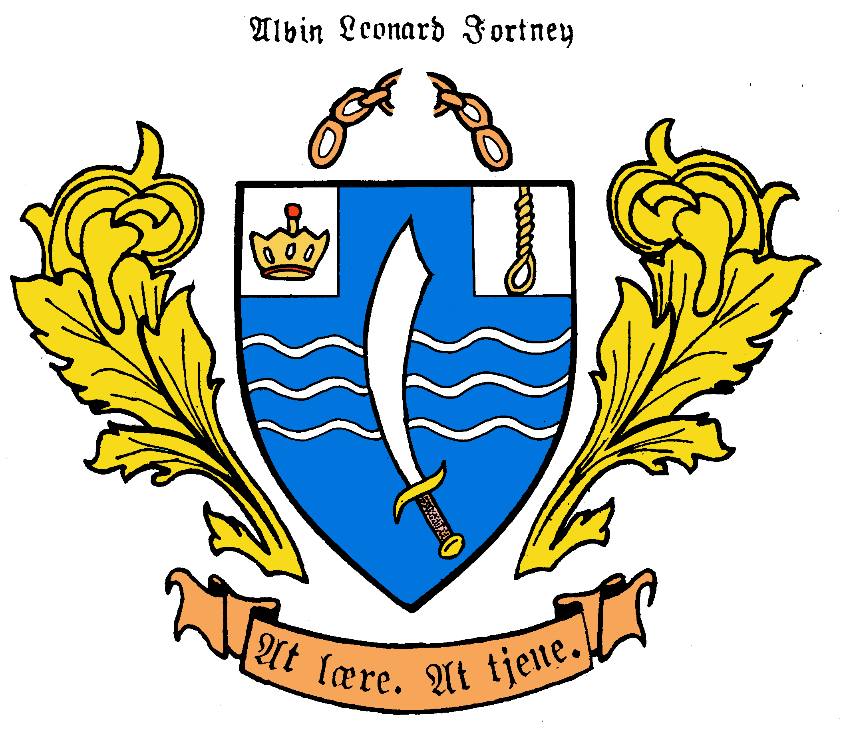
[ III ] Family Tree Branches: Steven Dale Fortney
Third Generation Norwegian American
Son of Albin Leonard & Anita Linnea Sodergren Fortney
Name: Melissa Christine
B/Plc: 18 January 1961; Minneapolis, Minn.
D/Plc:
Occupation: Teacher
S/C: James Shanks/2 dau
Name: Steven Dale Fortney
Born: 2 January 1937; Minneapolis,MN
Deceased:
Occupation: Teacher; Writer
Name: Minda Dianne
Born: 10 January 1963; Stoughton, WI
Occupation: Teacher
S/C: Frank Byrne/1 son, 2 dau.
Married: January 1960
Place: Minneapolis, MN
Name: Alexander Kendall
Born: 9 October 1968; Stoughton, WI
Occupation: Teacher
S/C: Chris Marsh/ 2 sons
Name: Ruth Ann Geyer Fortney
Born: 19 February 1939
Deceased:
Occupation: mother, housewife, Teacher
Name: Sigrid Andrea
Born: 11 October 1970; Stoughton, WI
Occupation: Teacher
S/C: Christopher Alakel 1 dau. Born April 2007
Steven & Ruth Fortney
3 daughters, 1 son
8 grandchildren

Slide 18
[III] Family Tree Branches: Alan Jon Fortney
Third Generation Norwegian American
Son of Albin Leonard Fortney [II]
Name: Alan Jon Fortney
Born: 18 November 1939;Cleveland, OH
Deceased:
Occupation: Writer, etc; Teacher
Name: Rachael Jennifer Fortney
B/Plc:1 December 1970
D/Plc:
Occupation:
S/C:
Married: 26 July 1980
Place: Bennington, VT
Name: Kendall Anders Fortney
B/Plc:5 July 1981
D/Plc:
Occupation: Artist
S/C:
Name: Jill Andersen Fortney
Born: 15 June 1951
Deceased:
Occupation: Teacher, mother, housewife,

Slide 19
[III] Family Tree Branches: Anita Linnea Fortney Harms
Third Generation Norwegian American
Daughter of Albin Leonard Fortney [II]
Name: Anita Linnea Fortney Harms
Born: 3 July 1947, Tacoma, Washington
D/Plc:
Occupation: Teacher (retired), creative dramatics
Name: Robin Harms
B/Plc: 29 January 1980; Muskegon, MI
Married/Plc: 27 December 2006, Muskegon MI
Reception: 26 October 2007
Occupation: Students
S/C: Nathan Kingsley (10 July 1978, Columbus OH) ; 0
Married: 29 July 1972
Place: Muskegon, Michigan
Name: Burl (Bill) Harms
Born: 26 March 1947 D/Plc:
Occupation: Broadcaster (retired), sales

Slide 20
[ III ] Family Tree Branches: Thomas Andrew Larson
Third Generation Norwegian American
Son of Myrtle Susanna Fortney [II] & Andrew Larsen
Name: Thomas Andrew Larson
Born: 9 August 1938, Menomonie, Wi
D/Plc:
Occupation: Computer Data Specialist
Name: Kerry Dean Larson
B/Plc: 19 March 1960, Fairbanks AK
D/Plc:
Occupation: accountant
S/C: Elizabeth; 2 sons
Married: 28 December 1958, [div. 1963]
Place: ???
Name: Thomas Jefferson Larson
B/Plc: 4 July 1961
D/Plc: 5 July 1961
Name: Kathleen D. Koehler
Born: 30 December 1937
D/Plc:
Occupation: Bookkeeper
Name: Maureen Larson
B/Plc: 1962
D/Plc: 1962

Slide 21
[ III ] Family Tree Branches: Mary (middle name) Larson Langford
Third Generation Norwegian American
Daughter of Myrtle Susanna Fortney [II] & Andrew Larsen
Name: Lynn Marie Langford
B/Plc: 7 November 1962, Menomonie WI
D/Plc:
Occupation: Special Ed Paraeducator
S/C: Jeffrey Jones; 1 son, 2 dau.
Name: Mary Ann Larson Langford
Born: 17 February 1941, Menomonie WI
Deceased:
Occupation: Registered Nurse
Name: Laura Beth Langford
B/Plc: 9 October 1965, US Army Hospital Japan
D/Plc:
Occupation: Regional Human Resource manager
S/C: Richard Waleen; 2 sons
Married: 31 March 1962 [Dvcd 1975]
Place: Our Saviors Lutheran, Menomonie WI
Name: John Herbert Langford
Born: 29 October 1939, Menomonie WI
Deceased:
Occupation: Pharmacist
Name: Jonda Kay Langford
B/Plc: 1 December 1969, Baldwin WI
D/Plc:
Occupation: Business Owner, CEO
S/C: Daniel Martin; 1 dau.
Mary Larson & John Langford
3 daughters;
3 grandsons, 3 granddaughters

Slide 22
[ III ] Family Tree Branches: Linda Rae Larson
Third Generation Norwegian American
Daughter of Myrtle Susanna Fortney [II] & Andrew Larsen
Name: Aaron Richard Olson
B/Plc: .13 February 1968, Minneapolis MN
D/Plc:
Occupation: Teacher
S/C: Elizabeth; 1 son; 1 dau.
Name: Linda Rae Larson Olson
B/Plc: 16 August 1942, Menomonie WI
D/Plc:
Occupation: Teacher, choral director
Name: Ashley Renee Olson Keith
B/Plc: 11 May 1970, Minneapolis MN
D/Plc:
Occupation:
S/C: Spencer Keith, 1 son, 1 dau.
Married: 8 June 1963
Place: Our Saviors, Menomonie WI
Name: Richard Olson
Born: 5 April 1942
Deceased:
Occupation: Teacher
Name: Andrea Larson Bach
B/Plc: 8 October 1972, Minneapolis MN
D/Plc:
Occupation:
S/C: Keith Bach, 1 dau. 1 son
Name: Alexi LaRae Olson Thompson
B/Plc: 10 May 1975, Bloomington MN
D/Plc:
Occupation:
S/C: Zachary Thompson, 1 son, 1 dau.

Slide 23
[ III ] Family Tree Branches: Orland Larson
Third Generation Norwegian American
Son of Myrtle Susanna Fortney [II] & Andrew Larsen
Name: Daniel Patrick Larson
B/Plc: 1 October 1965; Washington DC
Occupation: Computer Consultant, Business owner
S/C: Julia Szabo 3 July 1999; Budapest Hungary: 1 Dau. Izabelle [2 Aug 05]
Name: Orland John Larson
Born: 14 February 1944
Occupation: Marketing (Hewlett-Packard (Ret.) Business Owner
Married:
Place:
Name: Kathleen Lucille Shanahan Larson
Born: 1 July 1947
Occupation: Real Estate Agent/Property Manager (ret.)
Name: Eric Orland Larson
B/Plc: .16 October 1972; Mountain View, Calif.
Occupation: Real estate broker/ business owner.
S/C:
Orland & Kathleen Larson
2 sons
1 grandaughter

Slide 24
[ III ] Family Tree Branches: Laurel Larson
Third Generation Norwegian American
Daughter of Myrtle Susanna Fortney [II] & Andrew Larsen
Name: Luke Everett
B/Plc: 23 July 1972, Menomonie WI
D/Plc:
Occupation: Spanish teacher, coach
S/C: Jennifer Krenzelok, 1 dau.2 sons
Name: Laurel Jean Larson Madsen
B/Plc: 25 February 1947, Menomonie WI
D/Plc:
Occupation: Reading teacher (ret.)
Name: Josh Andrew
B/Plc: 12 July 1974
D/Plc:
Occupation: custodian
S/C: 0/0
Married: 6 April 1968
Place: Menomonee WI
Name: Larry “Ollie” Dean Madsen
Born: 13 January 1944, Menomonee WI
Deceased:
Occupation: Social Studie Teacher (ret.)
Name: Jed Thomas Matthew
B/Plc: 21 December 1977
D/Plc:
Occupation: Tru-Green Lawn manager
S/C: Cindy; 1dau., 1 son
Name: Jesse Jacob
B/Plc: 24 February 1979, Menomonee WI
D/Plc:
Occupation: Math teacher, coach
S/C: Devan; 2 dau.

